Slide 1
















Node.js
Mohamed Omran
Senior Software Engineer @The Fabulous

Slide 2


Slide 3


Slide 4
Content (Day 3)
Notes
Demo
RESTful Pattern
Express.js
Views (SSR vs CSR)
Pug template engine

Slide 5
Notes:
Early return
Flags
HOF
var/let/const
Work on big issue

Slide 6
Demo;

Slide 7
RESTful Pattern
Statelessness
Client-Server Architecture
Resource-Based
Representation

Slide 8
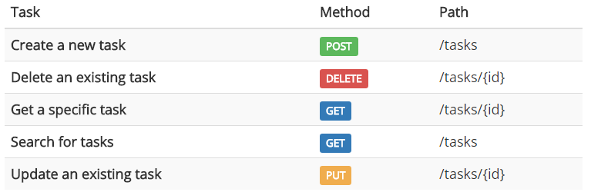
RESTful Pattern
GET /users/:id
POST /users
PATCH /users/:id
DELETE /users/:id
PUT /users/:id

Slide 9
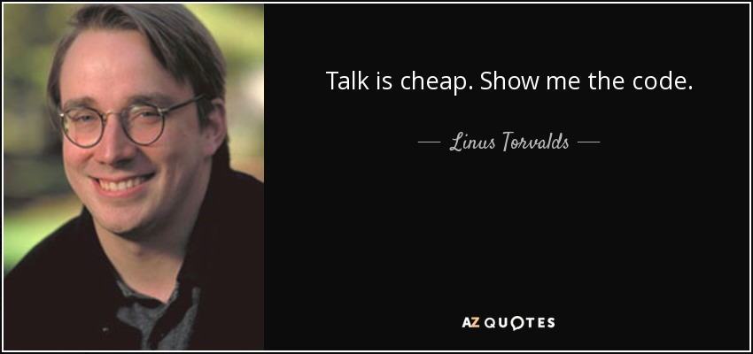

Slide 10
Express.js
Server
Routing ( patterns, params, query, postman )
Middlewares ( app, route, built-in, custom )
RESTful API (body)
Static Files

Slide 11
Views (SSR vs CSR)
Pug Template Engine

Slide 12
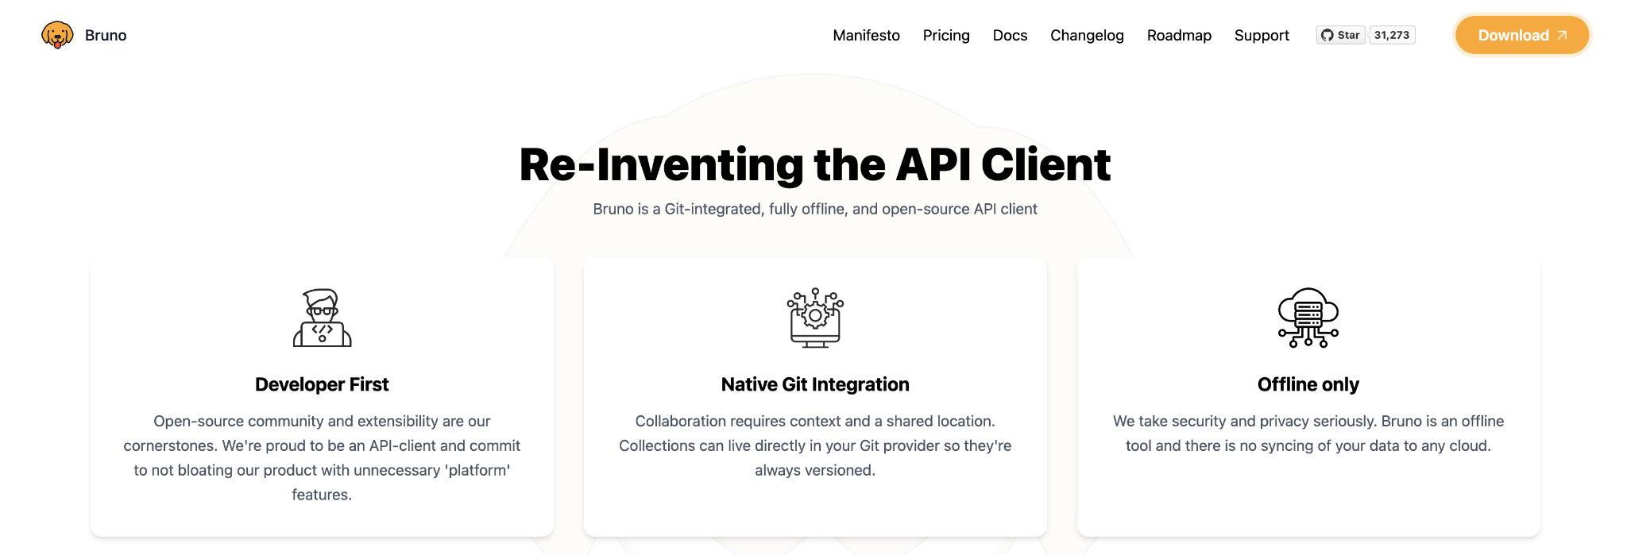

Slide 13


Slide 14
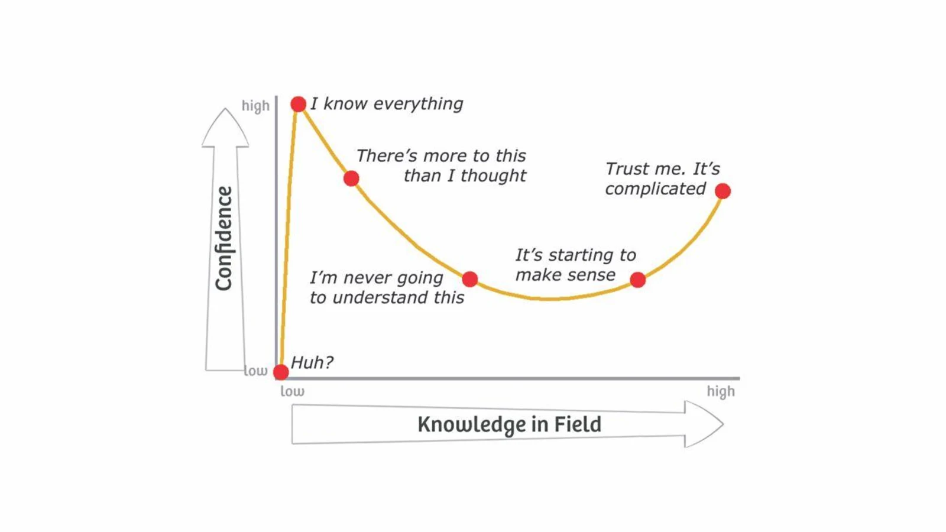

Slide 15
Lab Rules;
Separate sections
Assignment
In/Out

